Slide 1

FRAGMENTS

Slide 2

HOW DEEP IS YOUR LOVE?
Self-acceptance
Trial
Past regrets
Working through
Reassembly

Slide 3




BASICS
Notes:
Hand over to Lars

Slide 4

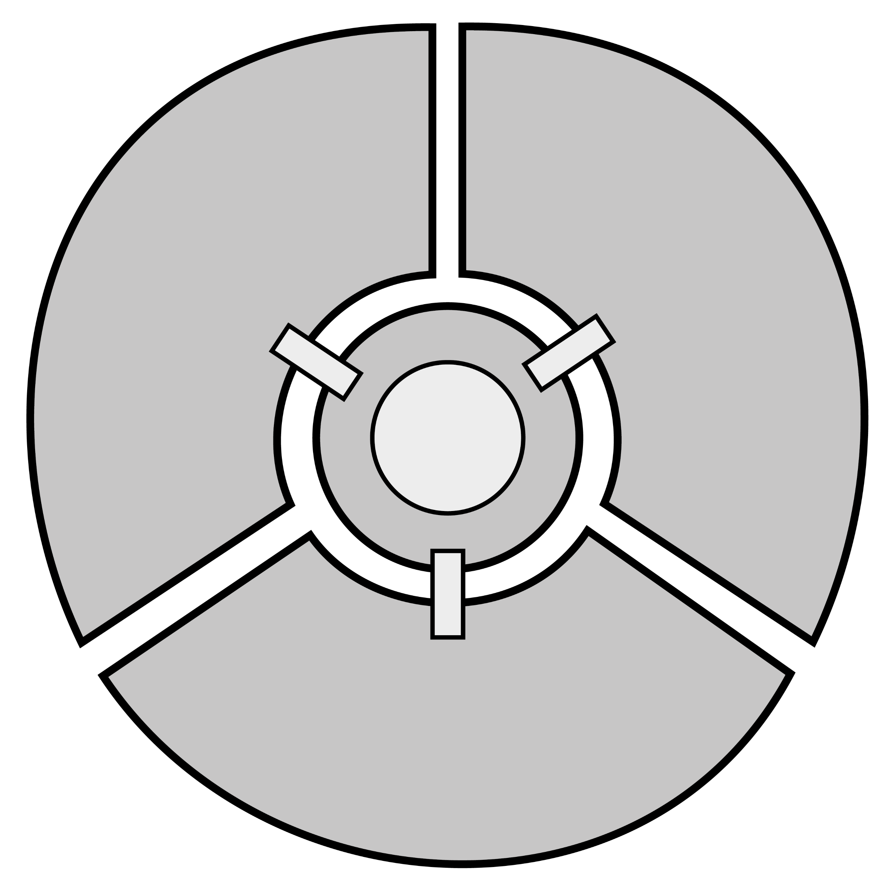
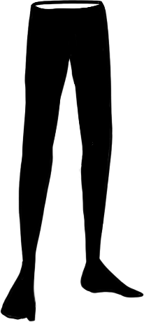


STRUCTURE
3
1
HUB
2

Slide 5


GAMEPLAY
Enter
Unlock
Analyze
Learn
Solve
Collect

Slide 6

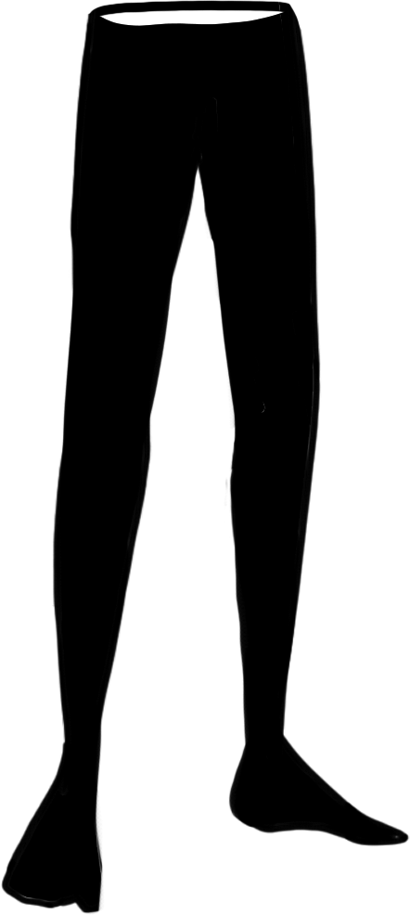


GAMEPLAY
Wall run
Push objects
Hook
Notes:
Hand over to Daniel

Slide 7



NARRATIVE

Slide 8


NARRATIVE
Running
away
Cowardice
Notes:
Hand over to Thiago

Slide 9



TECHNICAL APPROACH
Decoupled systems
Technical debt
Notes:
Hand over to Trix

Slide 10
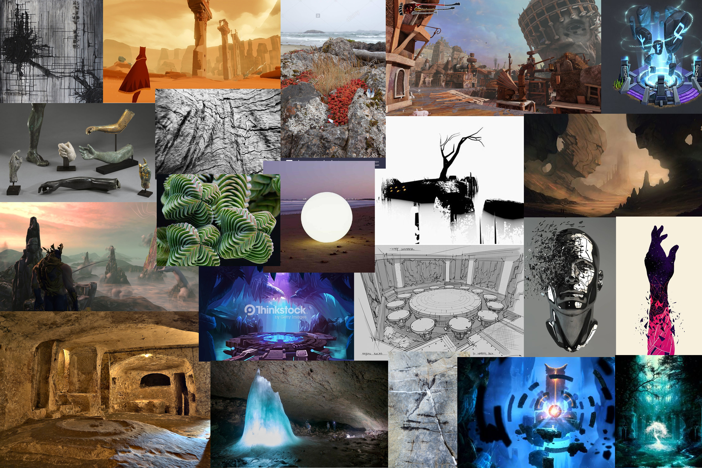

Slide 11

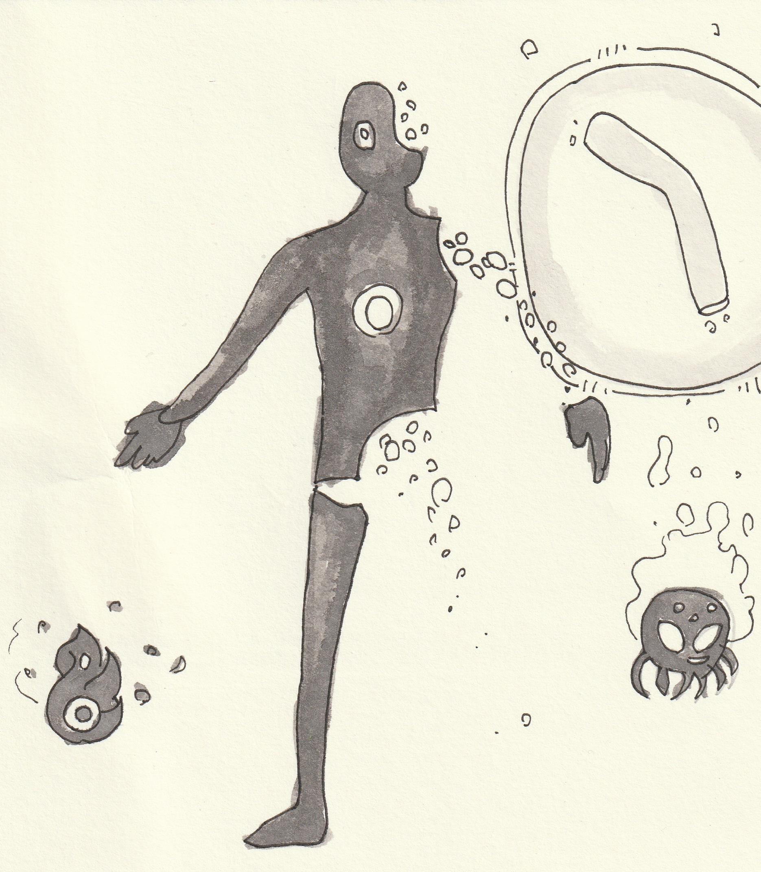
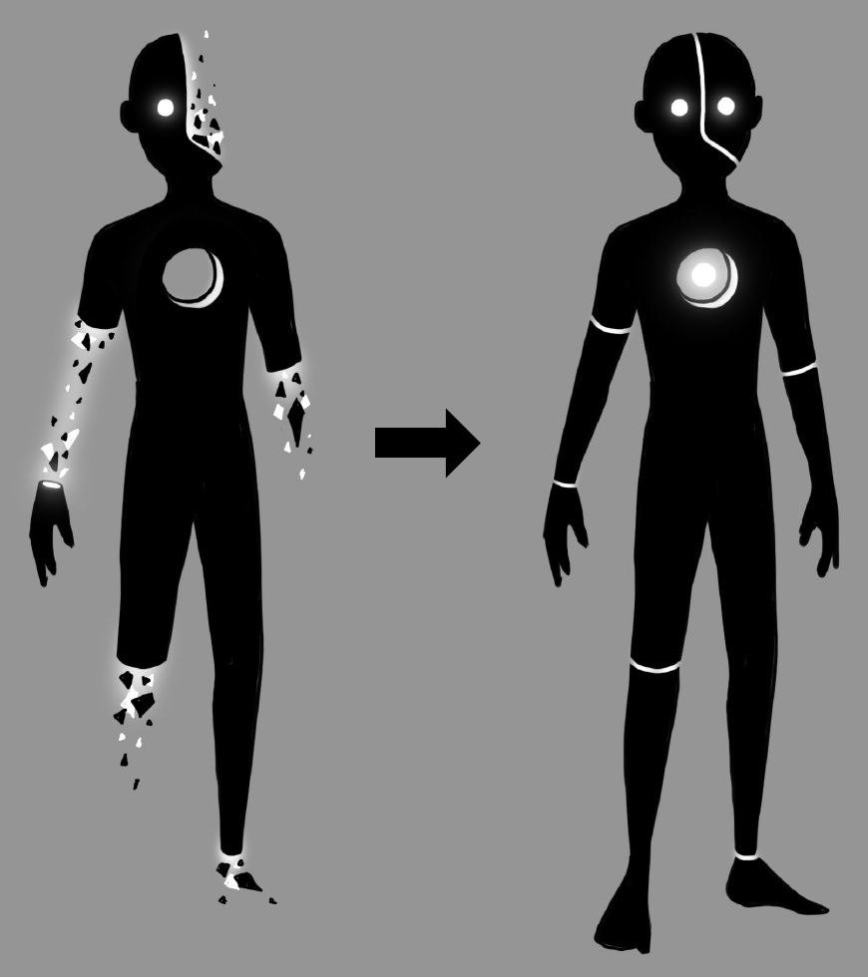
Art
Notes:
Hand over to Alex

Slide 12
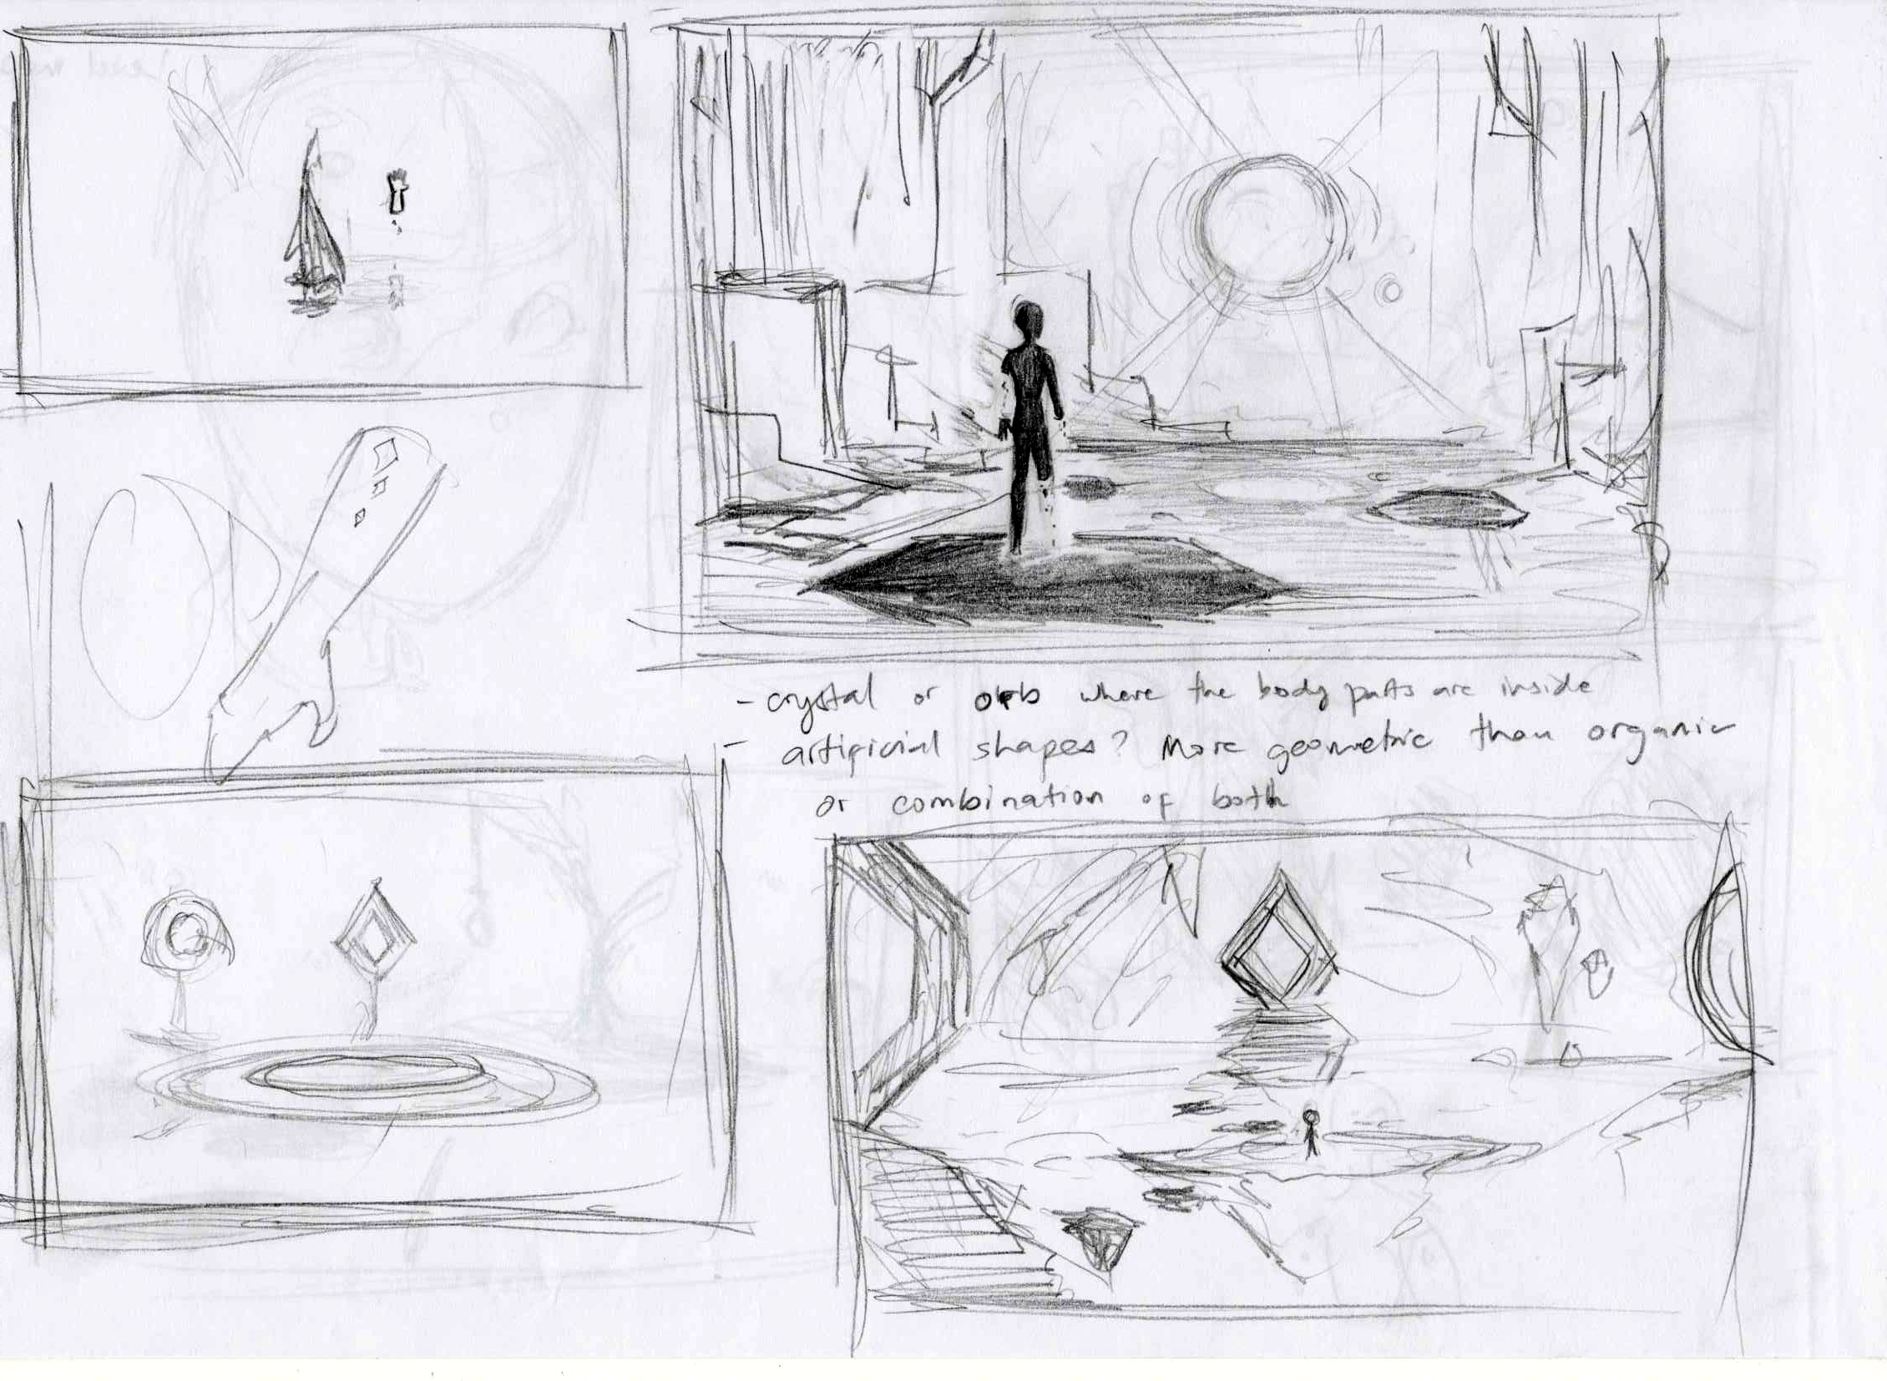
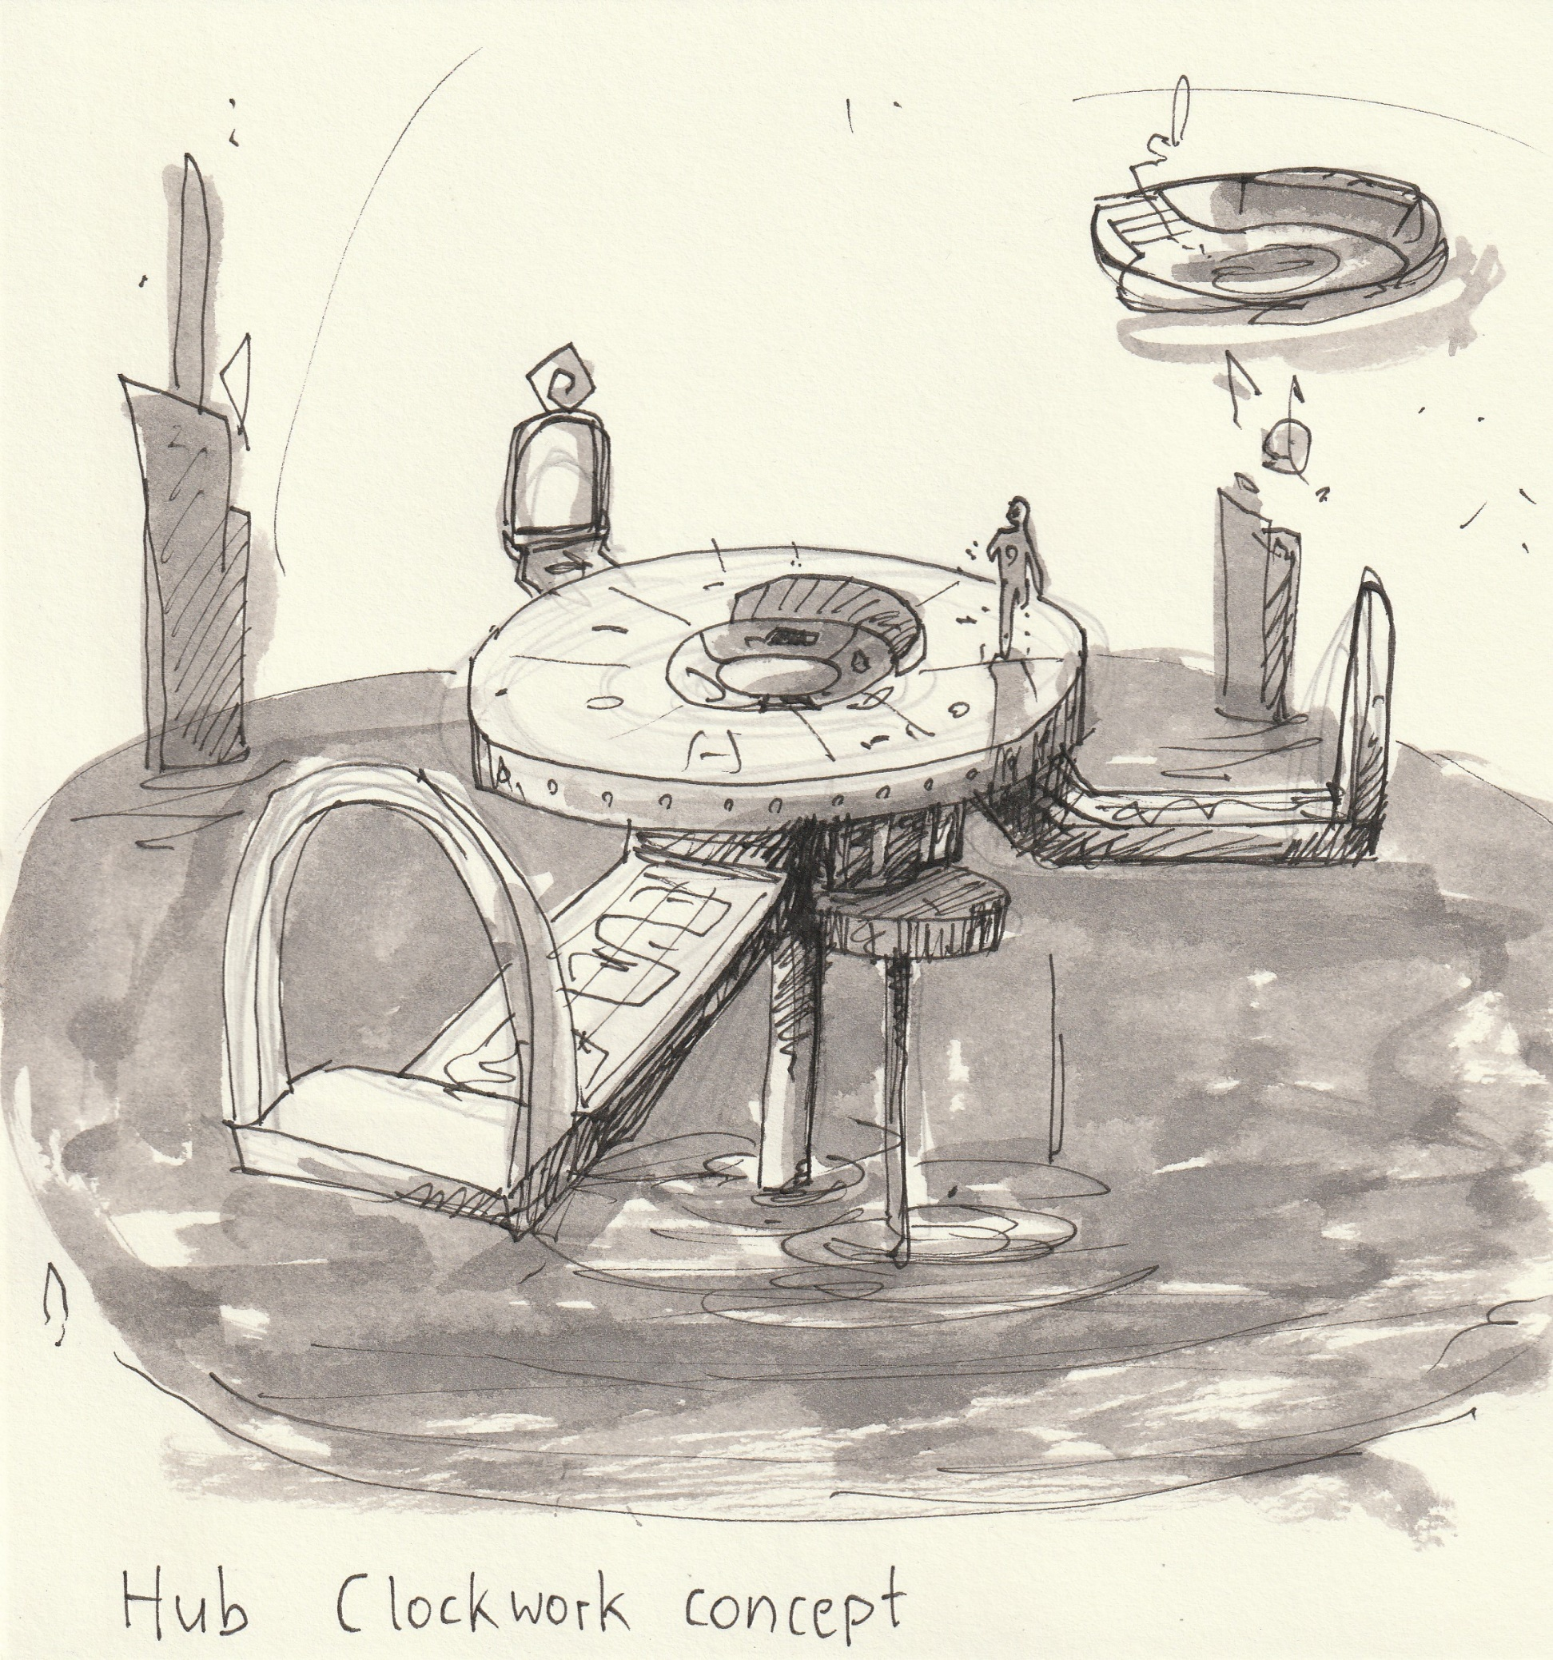
Art

Slide 13
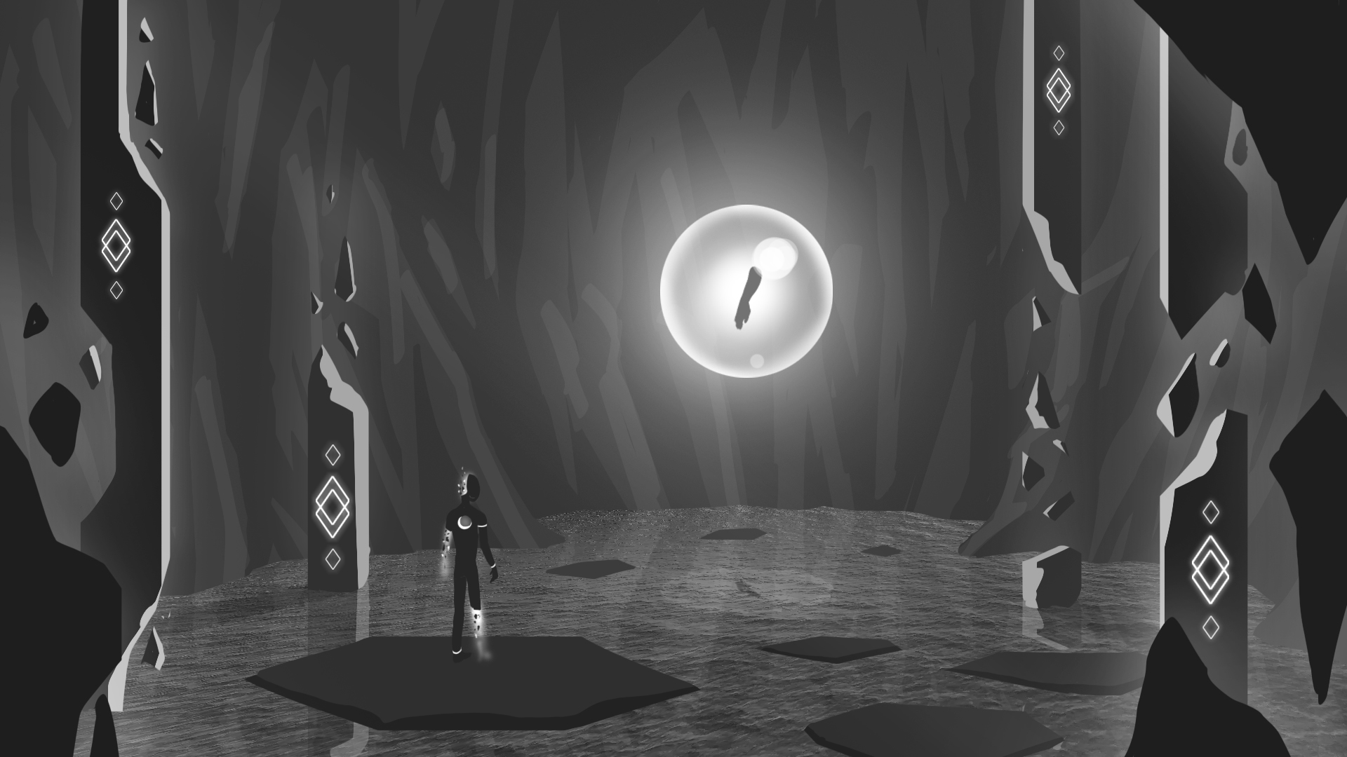

Slide 14
RIPOMATIC

Slide 15

THANK YOU!
Alexander Gerhards
Lead / Artist
Lars Kalthoff
Designer
Trixia Quinzon
Artist
Daniel Baracotti
Designer / Sound
Thiago Morano Gerding
Programmer

